Slide 1
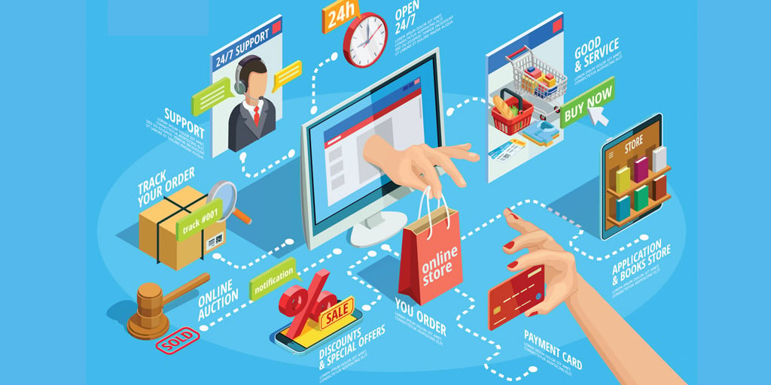

MyShop
Subscription-Based E-Commerce Application

Slide 2

Agenda
INTRODUCTION
Myshop Features and Walkthrough
Our learnings and insights
Whats Next
Conclusion

Slide 3
Group Members
Ankush Maity(Team Lead)
Omkar Wadekar
Tanmay Mutallik
Saurav Mohanty
Siddhesh Borse
Rishika Singh
Gayatri G

Slide 4
Subscription-Based E-Commerce Application MyShop
Project Overview: This web application enables customers to order and receive food products on a recurring basis through flexible subscription plans. It offers a wide range of products, including organic foods, ready-to-eat meals, and more, utilizing a replenishment subscription model for consistent, scheduled deliveries.
Key Features:
Subscription Management: Flexible plans (weekly, bi-weekly, monthly) with customizable schedules.
Admin Controls: Manage products and subscriptions, add new products to shop.
Customer Interface: Browse and subscribe to products, manage product subscriptions, edit personal profile, checkout and access order history.
User-Friendly UI: Intuitive pages for registration, login, and role-specific actions for both customers and admins.

Slide 5
Subscription-Based E-Commerce Application MyShop
UI Design:
Home Page: Navigation for registration and login.
Admin Page: Manage and add products, manage subscriptions, and view all users
Customer Page: Browse products and manage subscriptions and access order history.

Slide 6
Features and walkthrough
Let’s Dive In

Slide 7
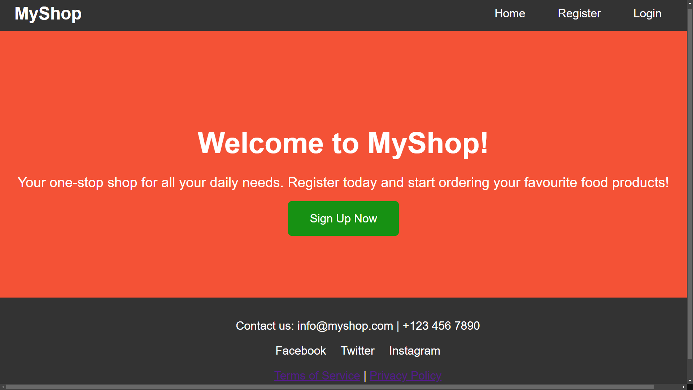

Slide 8
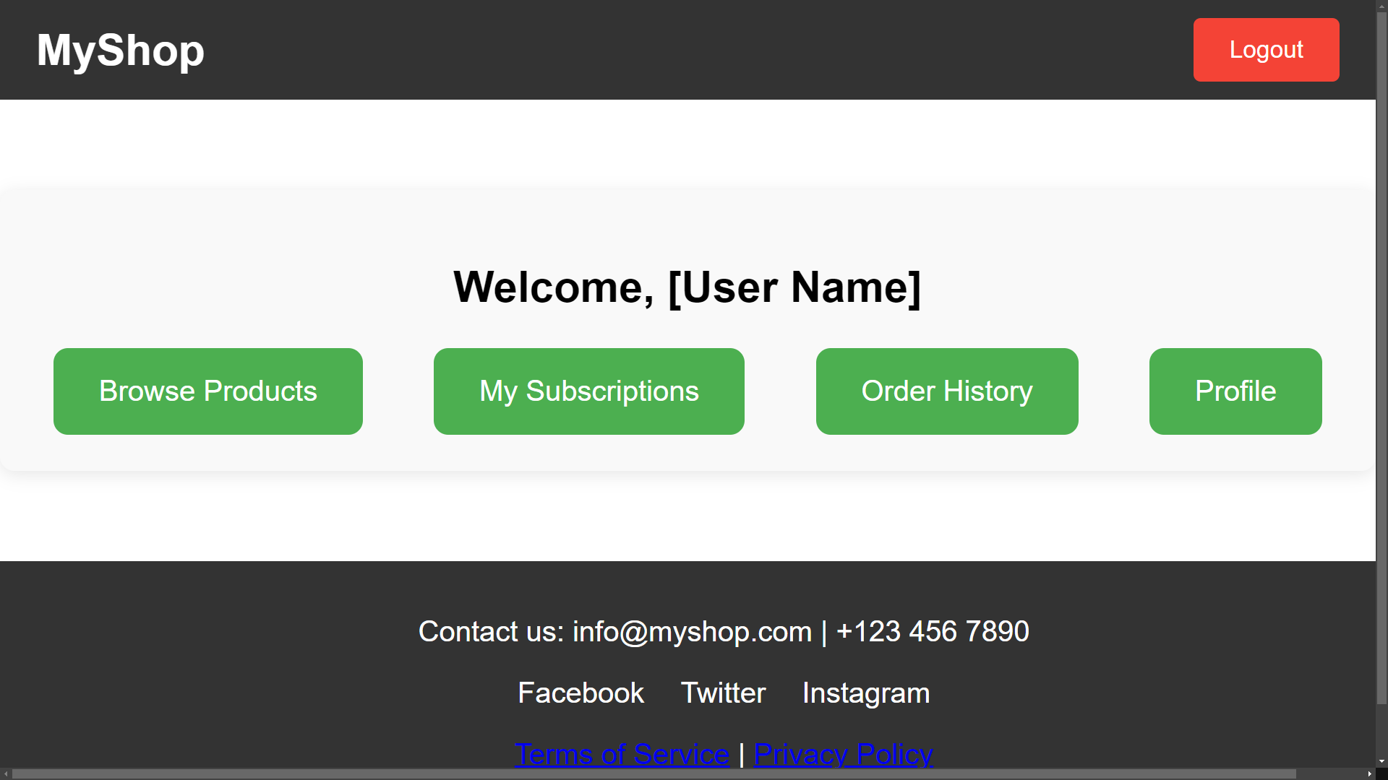

Slide 9
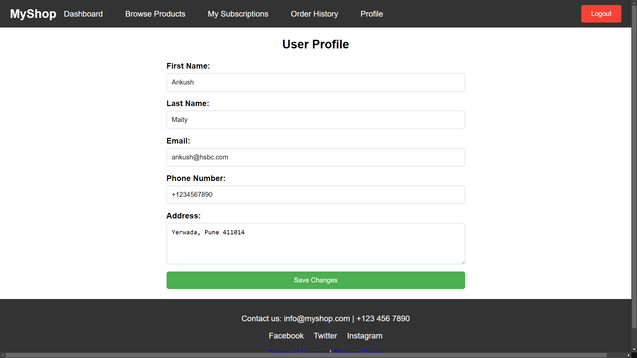

Slide 10
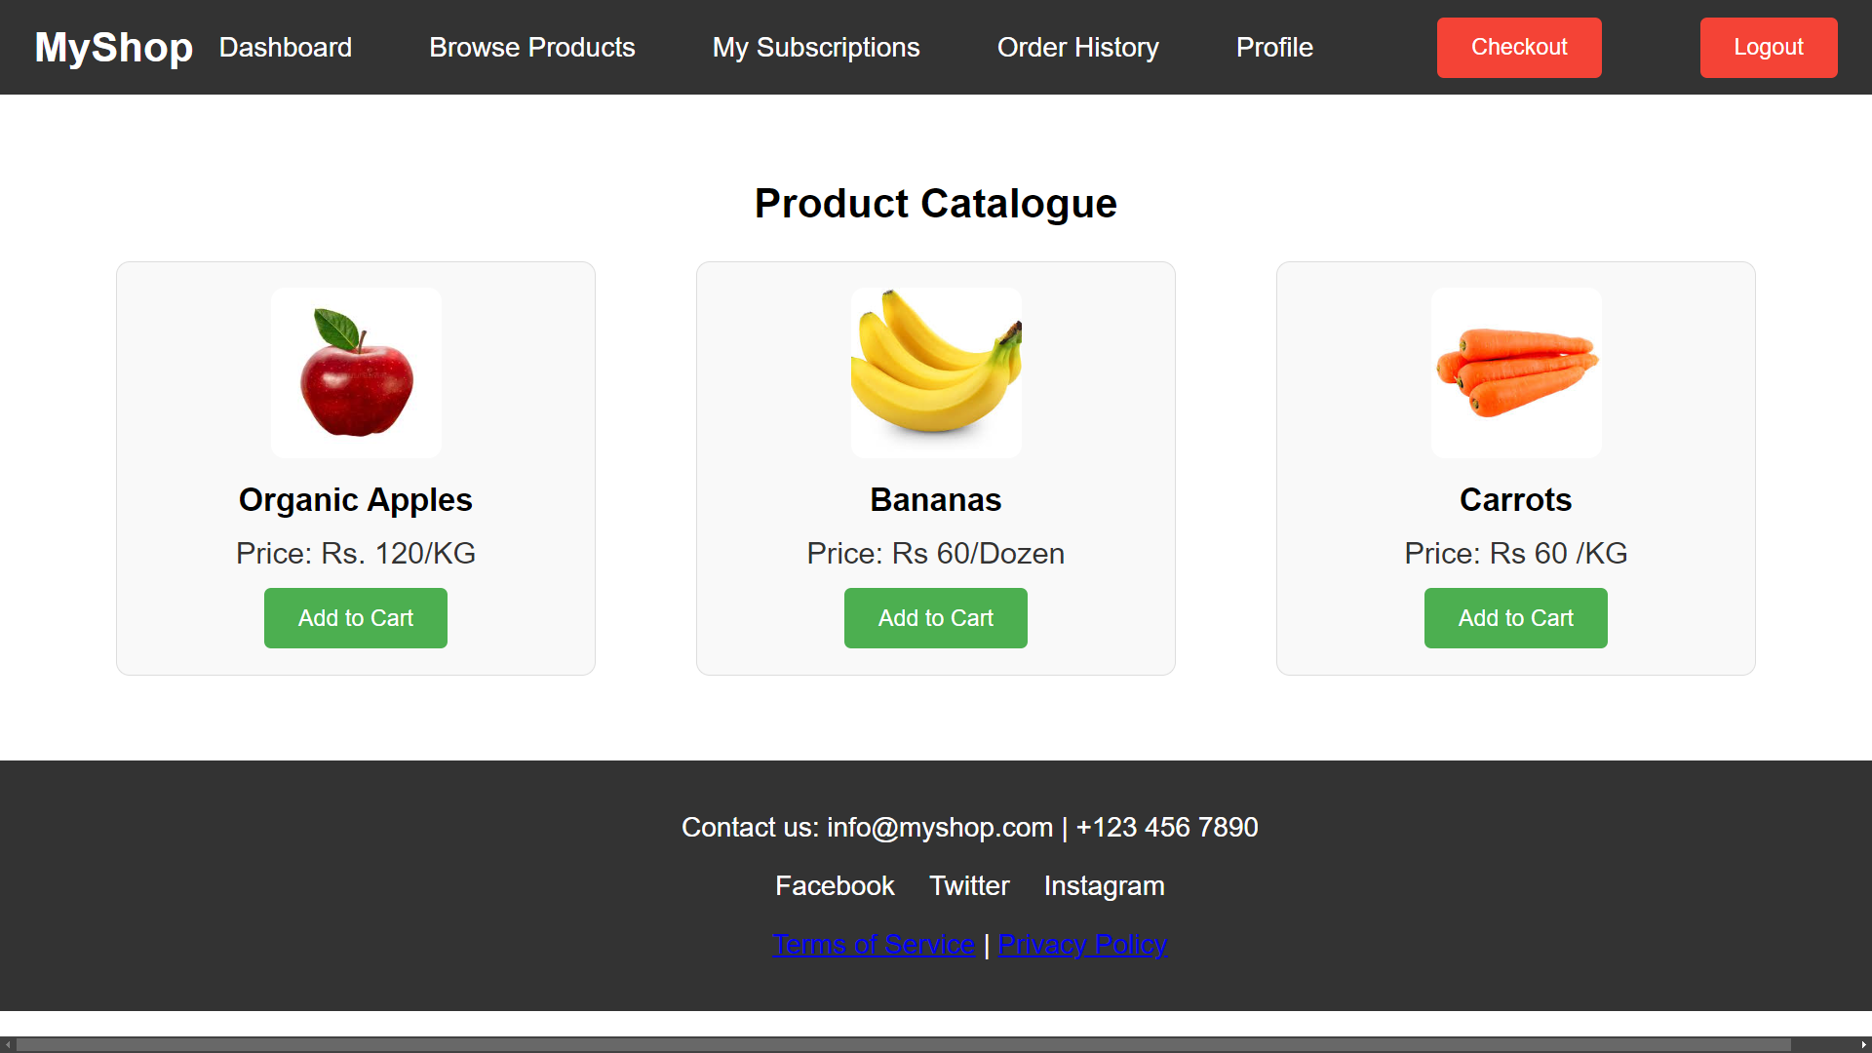

Slide 11
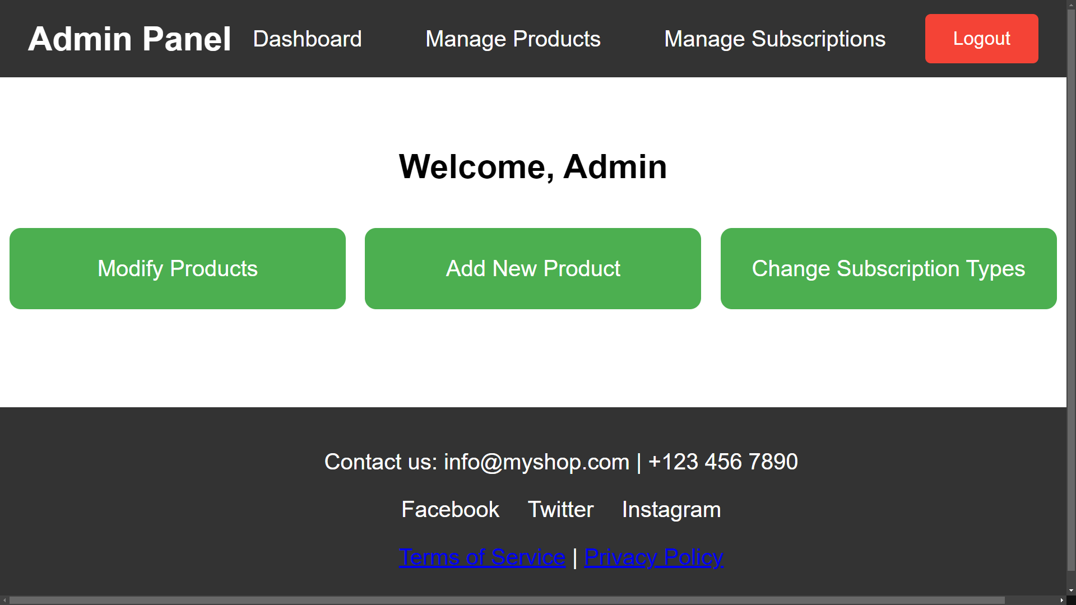

Slide 12
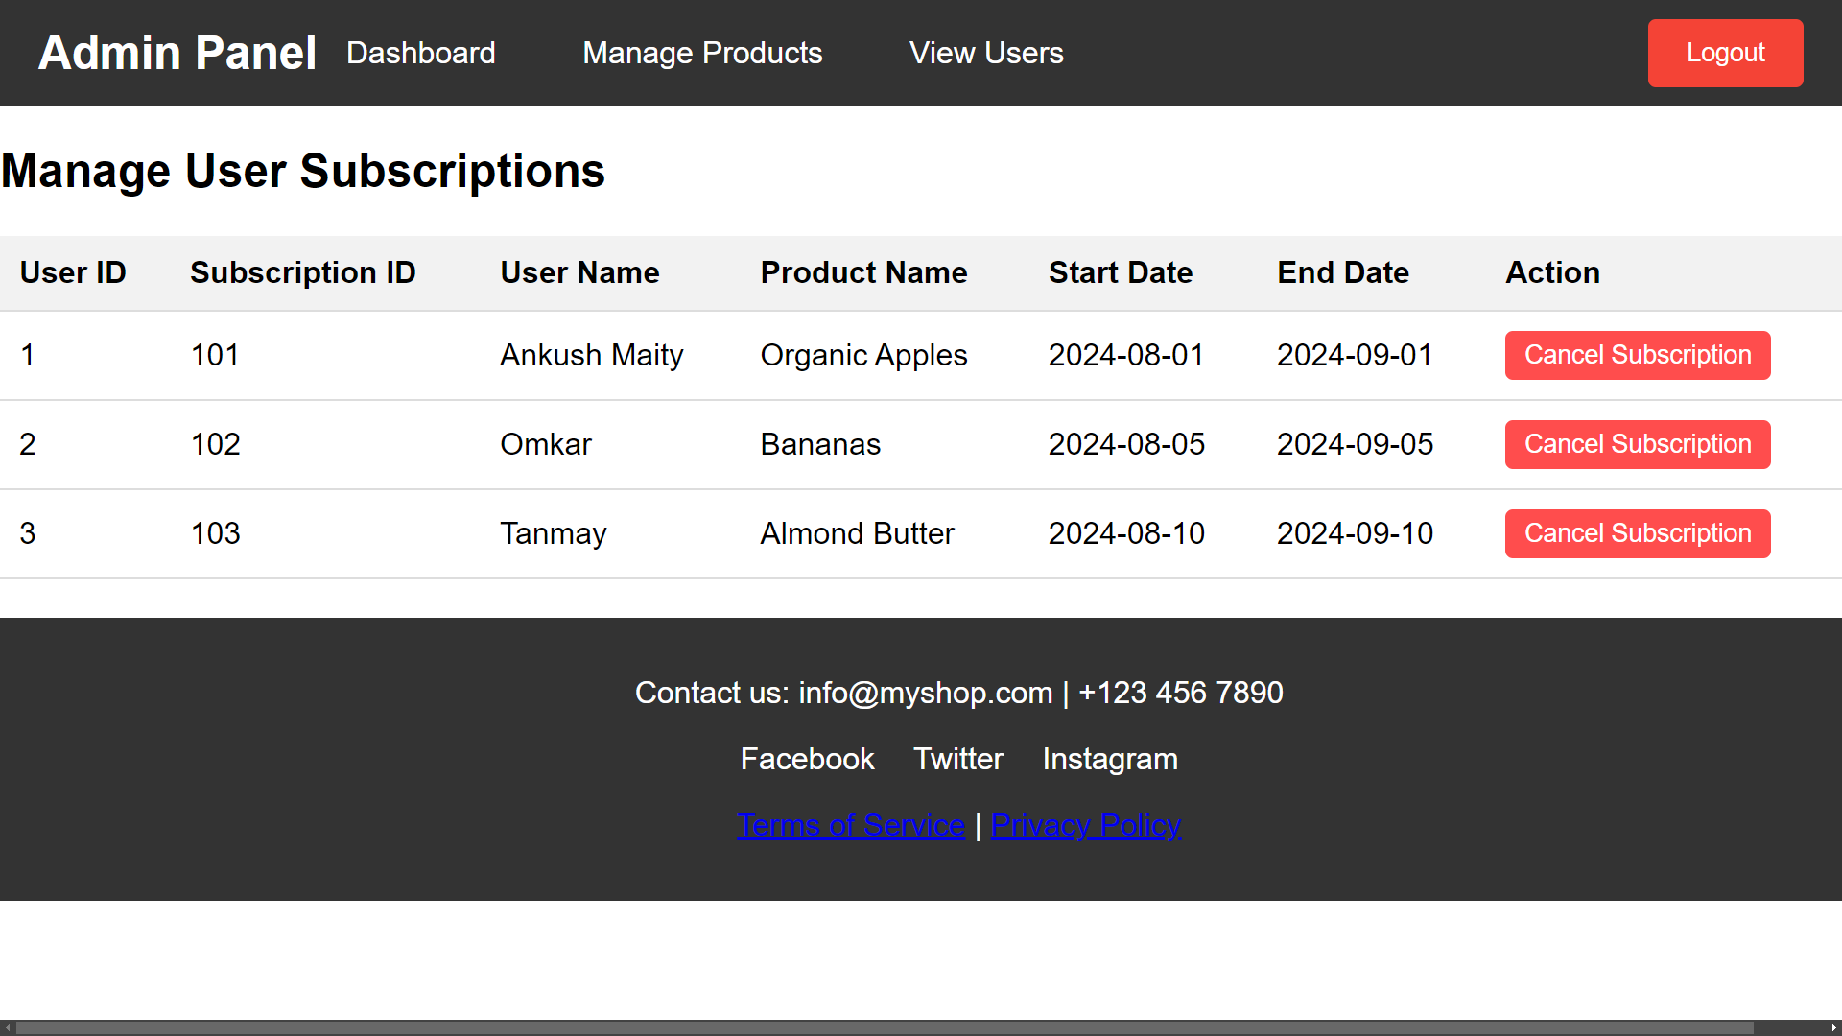

Slide 13
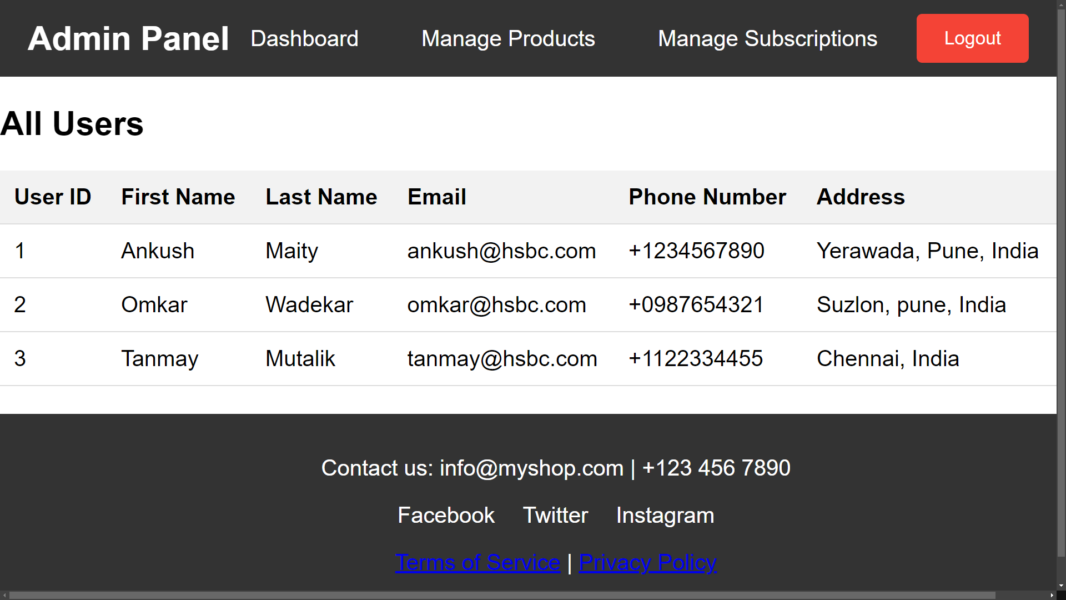

Slide 14
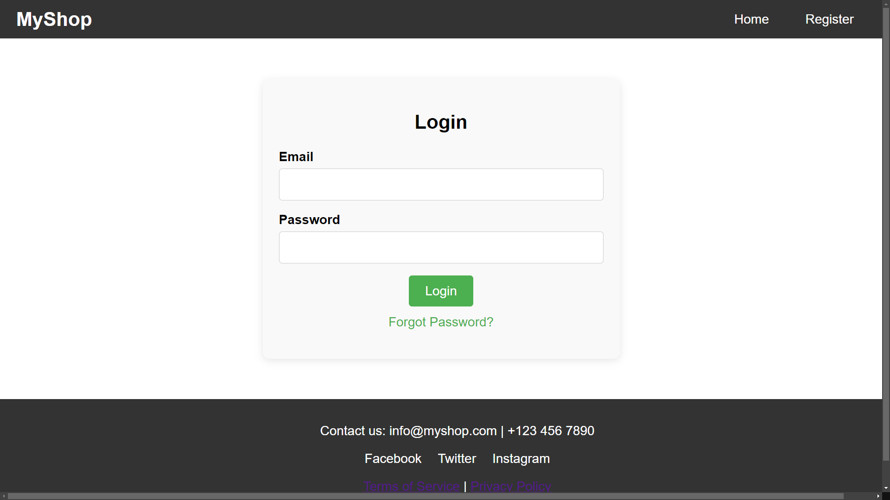

Slide 15

Features and Walkthrough
See how the magic happens!
Easy to use UI
Manage Products
User Management
Admin Management
Browse Products
Order History

Slide 16
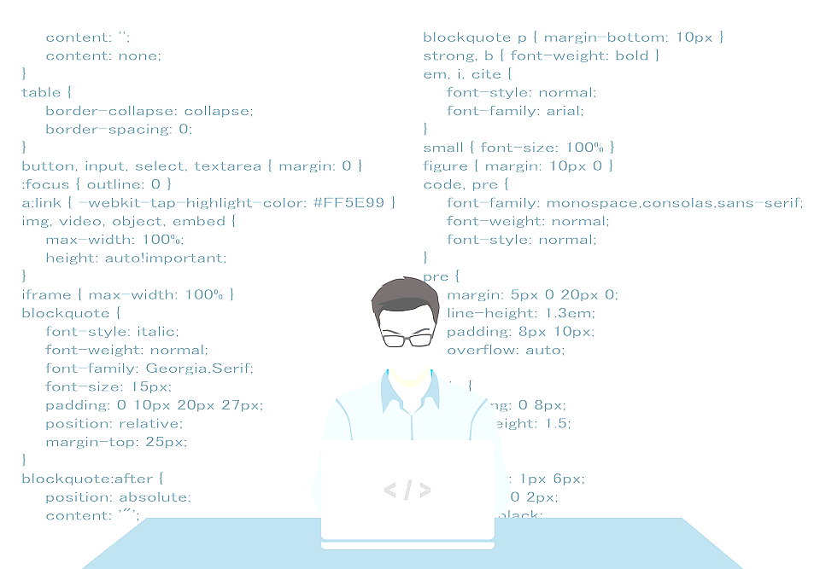
A Powerpacked dev team
Our Learnings and insights

Slide 17

Learnings and insights
Learning while building
Technologies Used
Java & JDBC: Developed backend logic and database interactions.
MySQL: Managed data storage for users, products, subscriptions , and orders
HTML, CSS, JavaScript: Built the frontend interface.
Team Learnings
Collaborative Development: Enhanced communication and teamwork, especially in managing code with Git.
Design & Architecture: Gained insights into system design principles and robust error handling.
Technical Proficiency: Improved skills in Java, JDBC, and MySQL, and learned best practices in web development.
Project Management: Learned effective time management and the value of iterative development.

Slide 18

Enhanced Collaboration
Improved teamwork and communication through version control
and shared development practices.
System Design Mastery
Gained proficiency in creating and implementing detailed design
diagrams
Technical Growth
Strengthened skills in Java, JDBC, MySQL, and web development, while learning to navigate and solve complex coding challenges.
Problem solving
Most important outcome of competition was helping us polish
our problem-solving abilities.

Slide 19

THANK YOU
Team Synergy sharks

